Slide 1
Lecture 38:
Carbohydrates
α-Amino Acids
Peptides

Slide 2
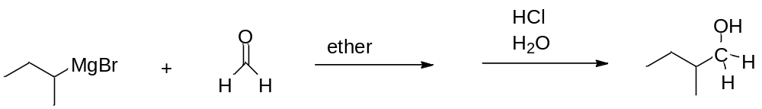
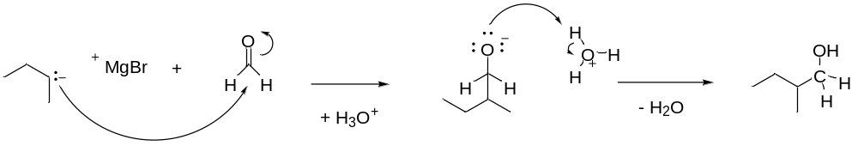
QUIZ: Show the mechanism and organic product of this reaction

Slide 3
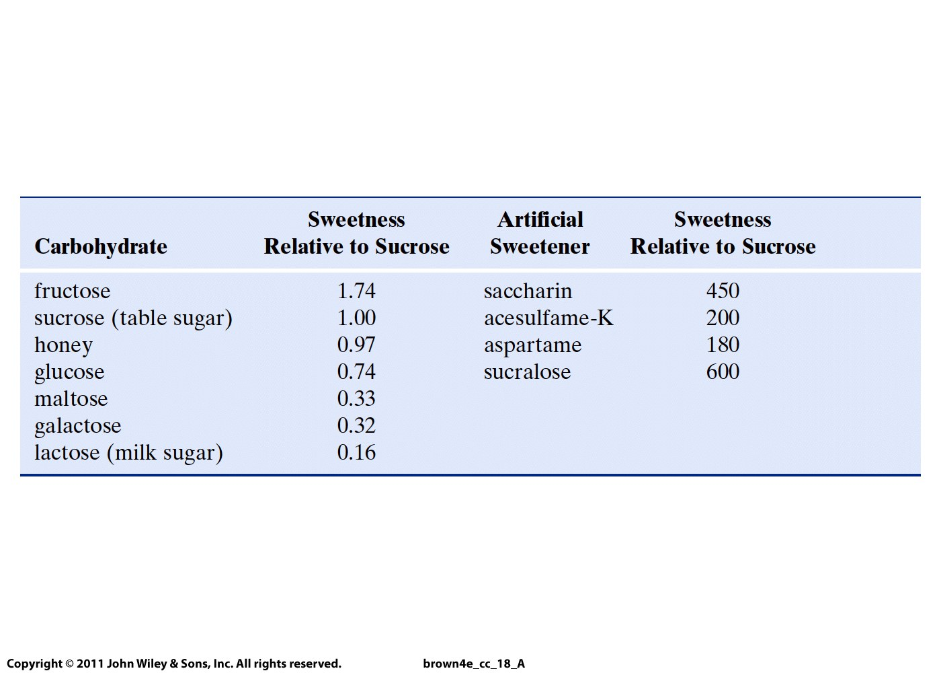

Slide 4
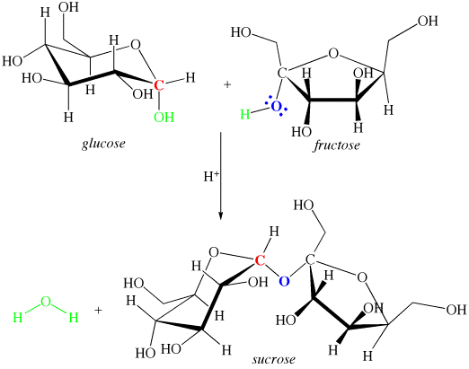
Formation of a glycosidic bond: C-O

Slide 5
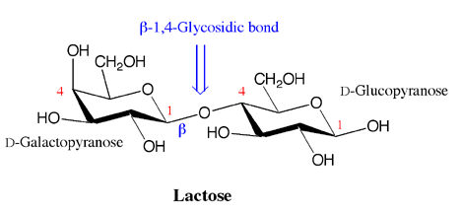
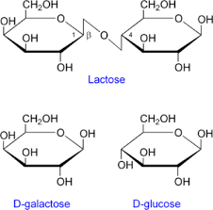
anomeric carbon
(milk sugar)

Slide 6
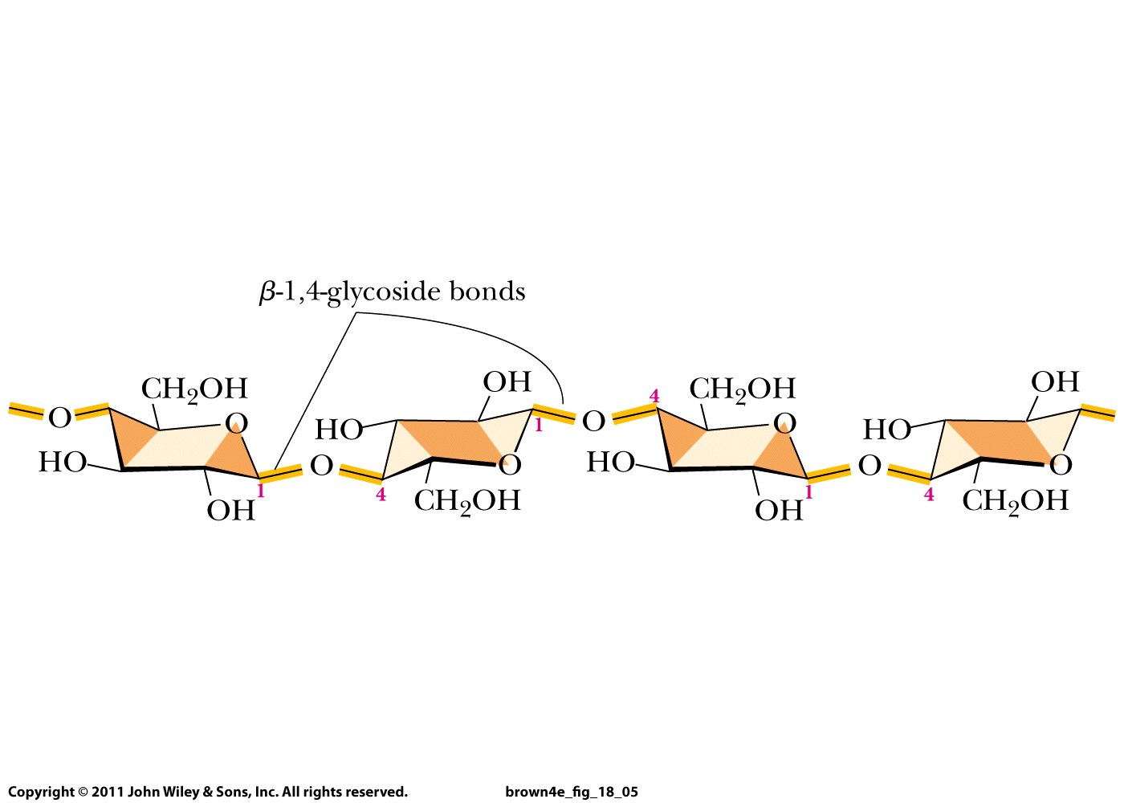
cellulose
Glucose molecules connected by β-1,4-glycosidic bonds

Slide 7
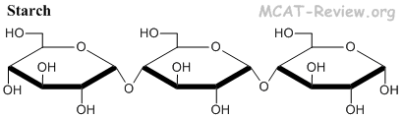
Glucose molecules connected by α-1,4-glycosidic bonds

Slide 8
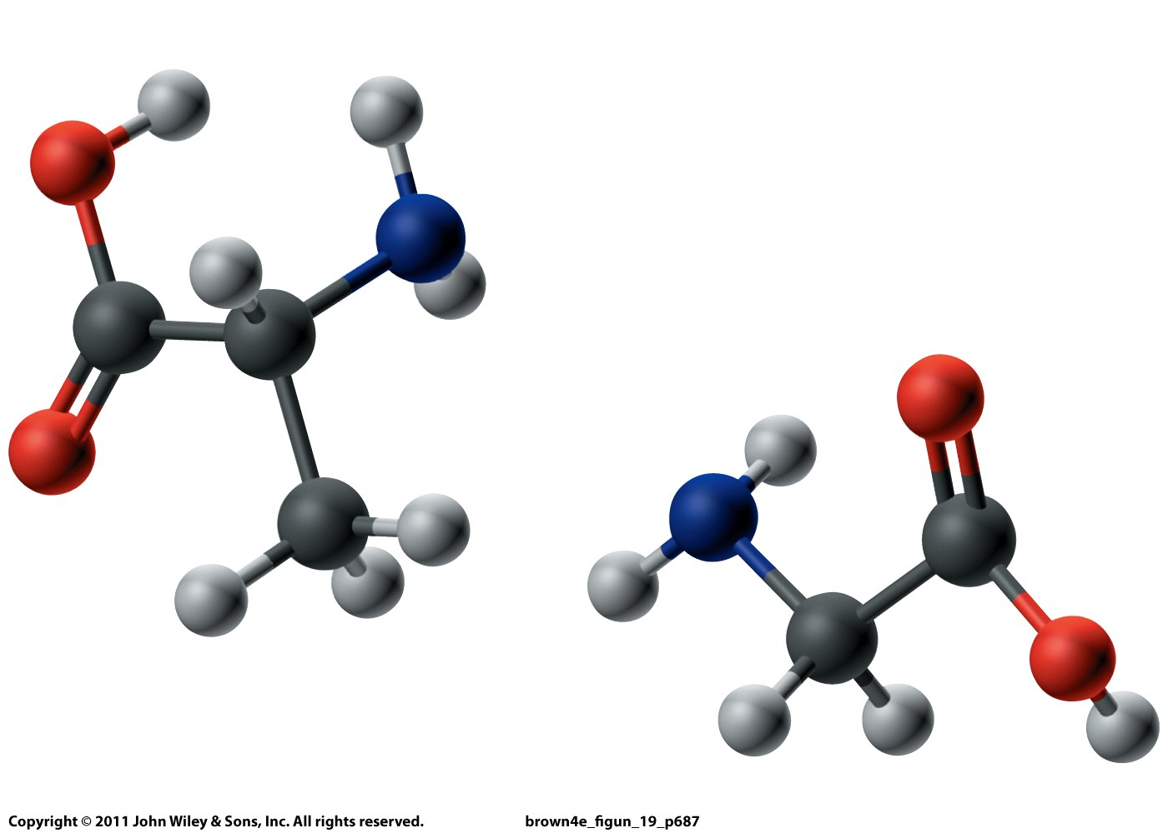
Glycine: R = H
Alanine: R = CH₃

Slide 9
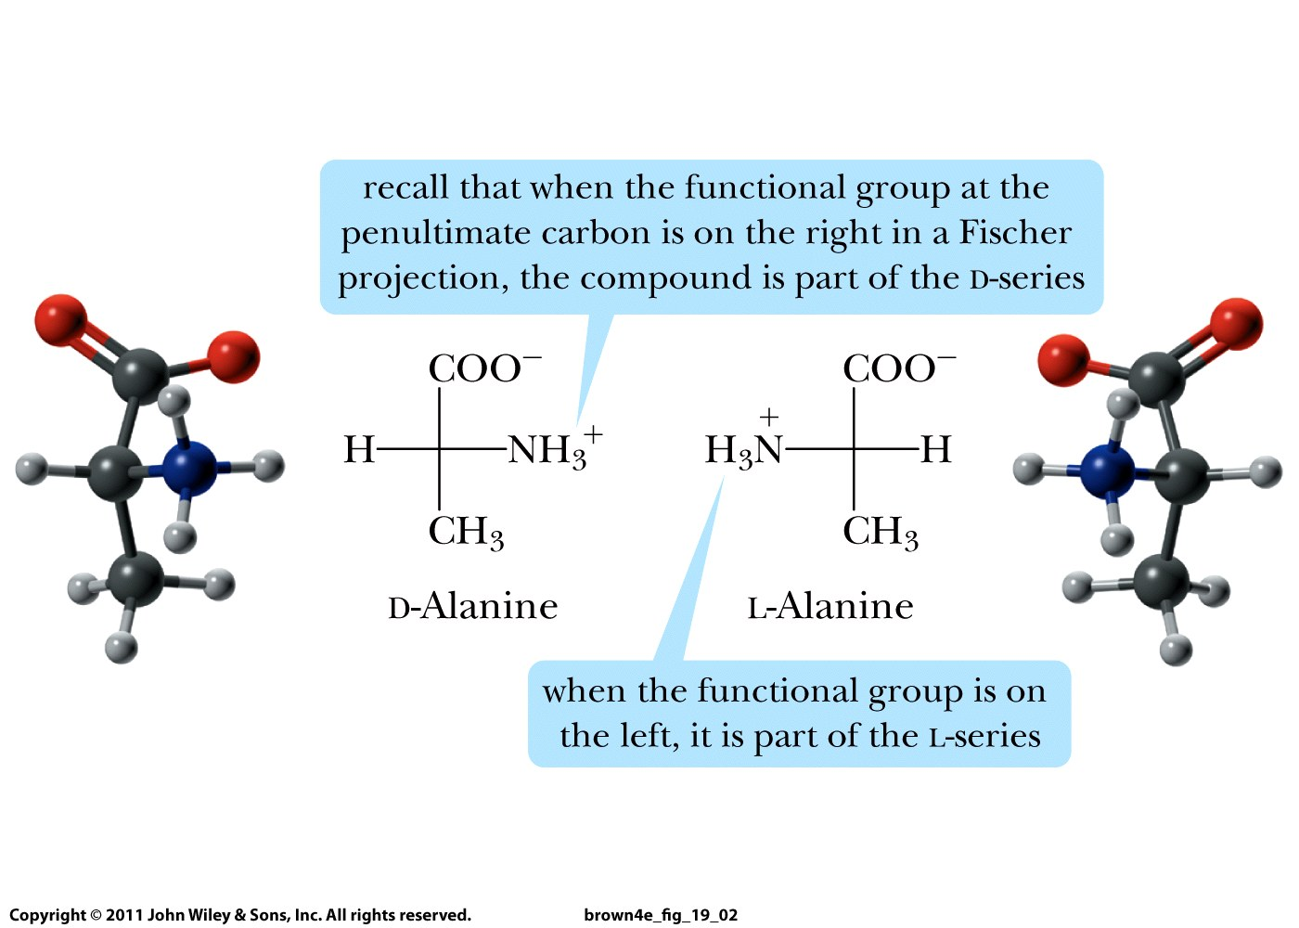

Slide 10
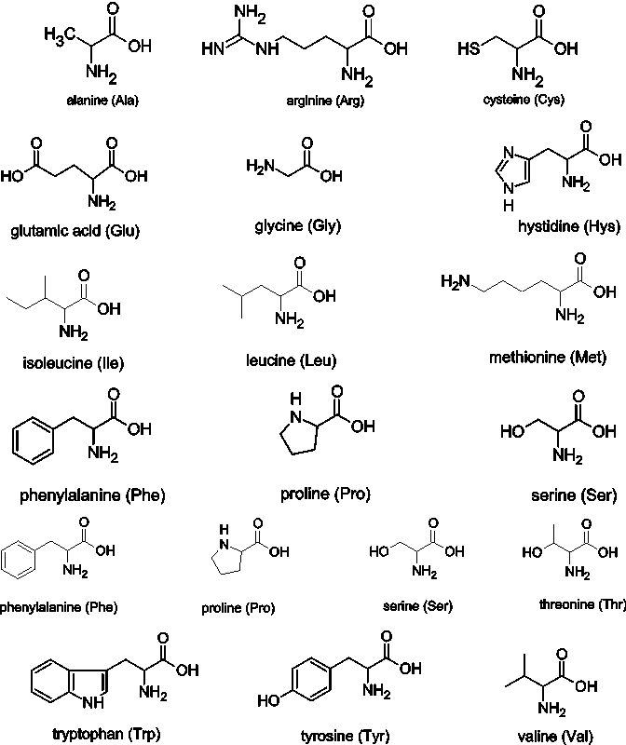
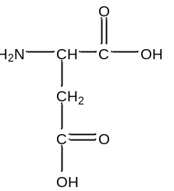
histidine
aspartic acid
lysine

Slide 11
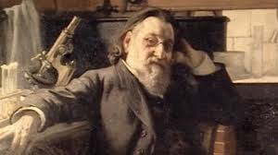
Emil Fischer – again!
In 1902, Fischer proposed that proteins are long
chains of amino acids joined by peptide bonds.

Slide 12
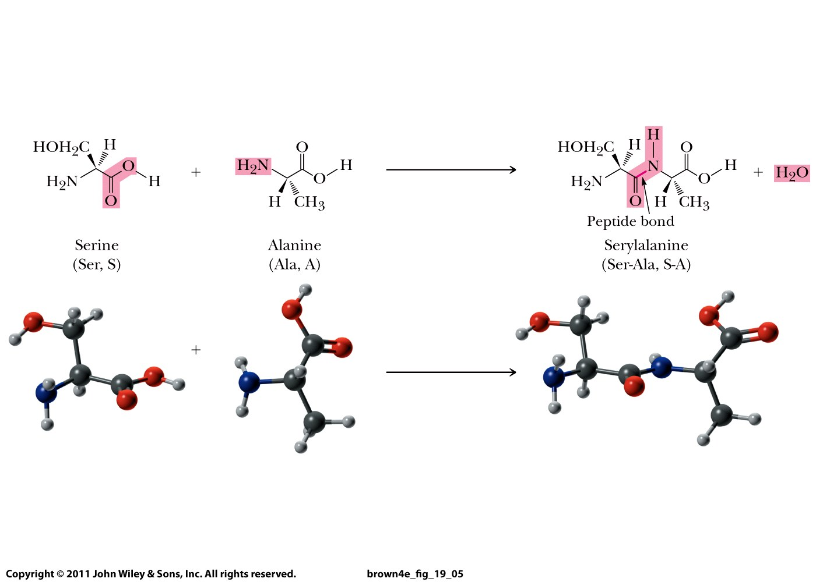

Slide 13
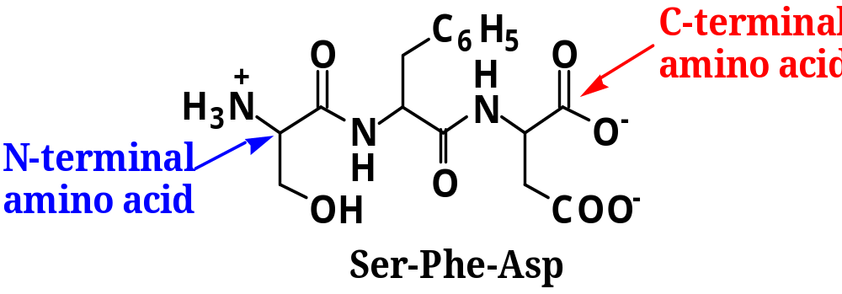

Slide 14
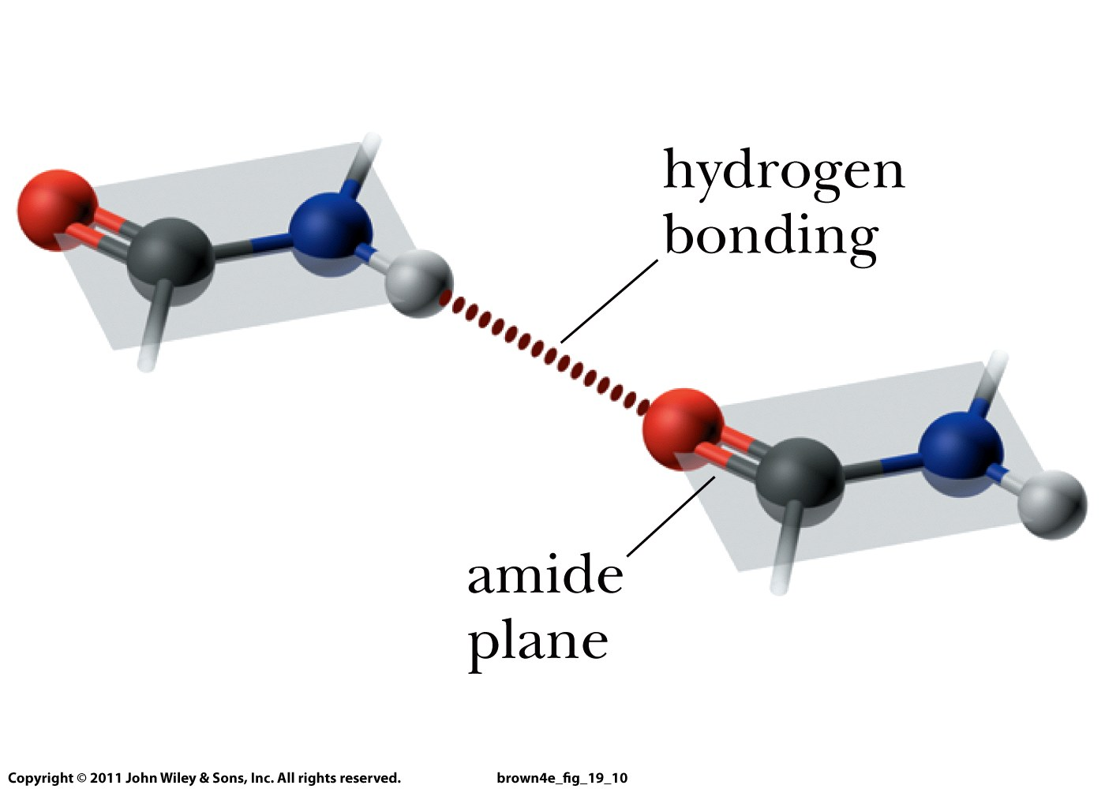

Slide 15
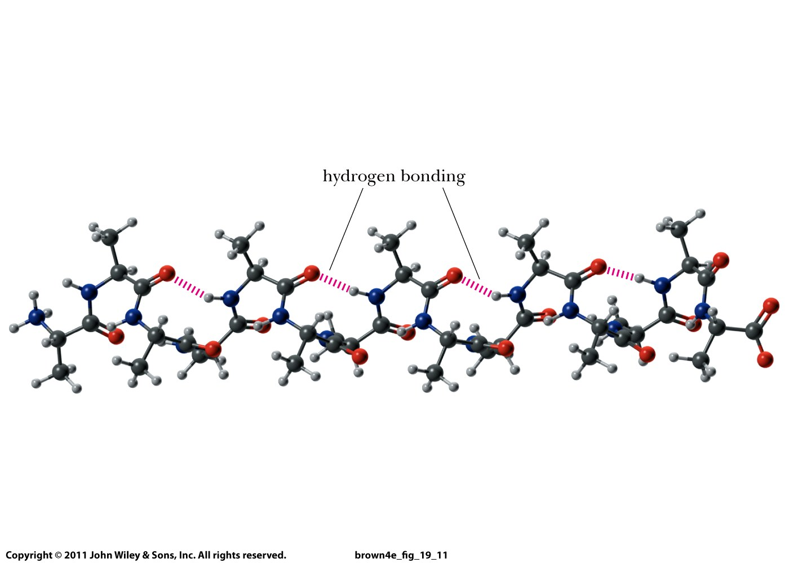

Slide 16
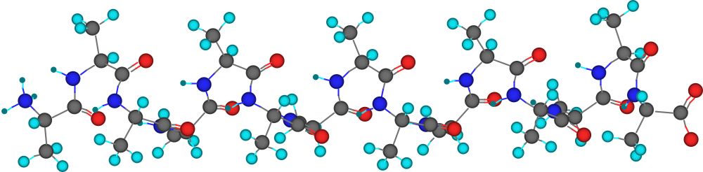
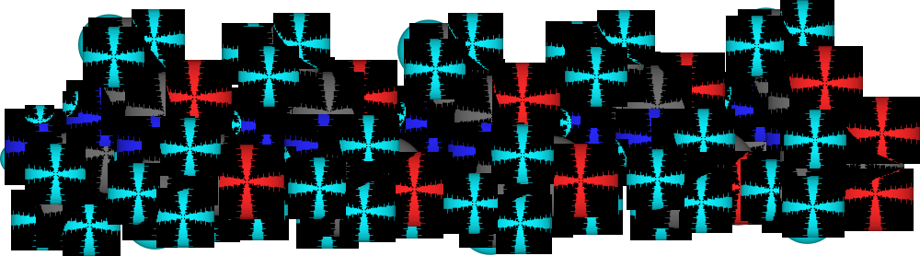
An α-Helix
Polyalanine, cylindrical bonds model, viewed along its length. Sites of H-bonding are visible.

Slide 17
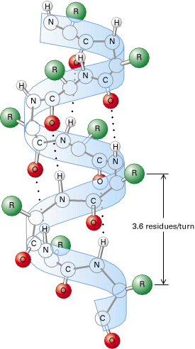

Slide 18
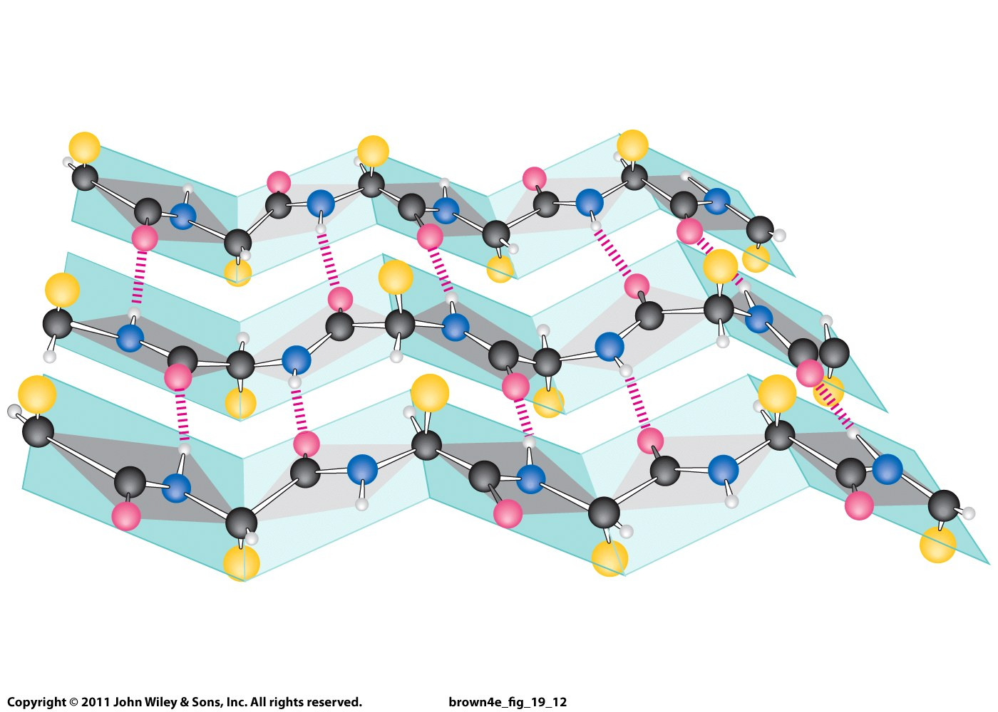
β-Pleated sheet conformation with three polypeptide chains running in opposite directions.

Slide 19
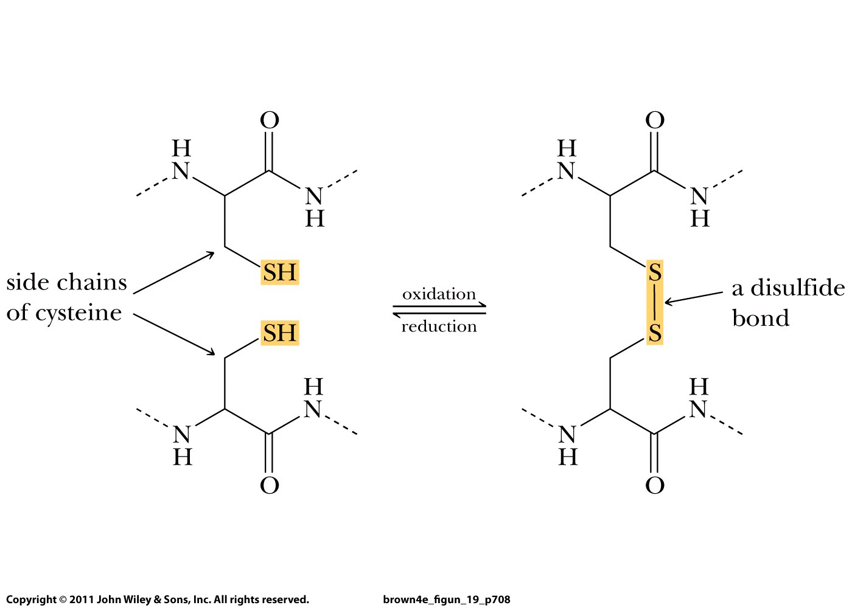

Slide 20
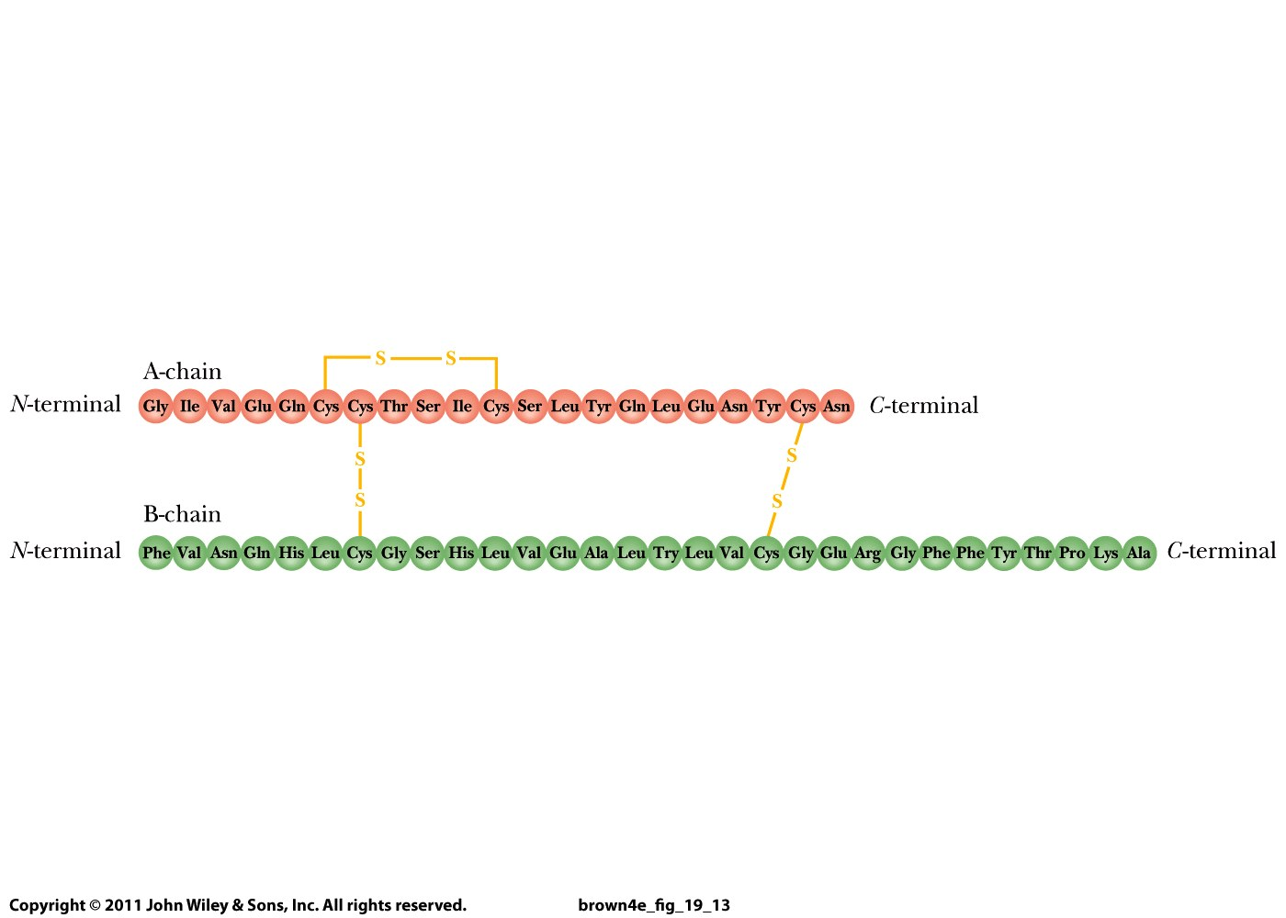
Internal disulfide bond
Intramolecular disulfide bonds

Slide 21
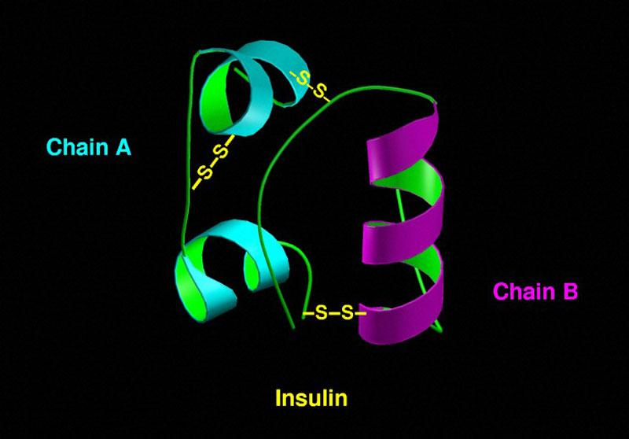

Slide 22
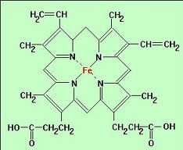
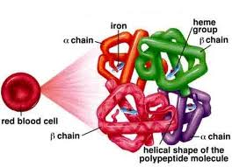
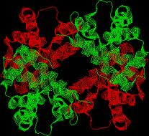
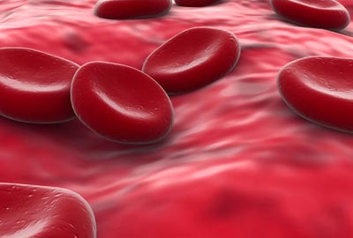
  Hemoglobin consists of two α chains and two β chains.

